Slide 1

Referral Refusal Requests
Atrezzo Submission Guide
Presented by:
Brianna Walton
Operations Manager for Kepro Maine
Notes:
Hello and Welcome to the Kepro Referral Refusal training guide. This video has been created to provide general guidance for Providers on how to submit an Referral Refusal in Atrezzo.
The guidance presented in this presentation is meant to give providers a basic understanding of the submission process in Atrezzo.

Slide 2
Agenda
Atrezzo Submission Process
Post Submission Process
Notes:
This training will cover the following topics; the Atrezzo submission process and post submission process

Slide 3
Part One
Atrezzo Submission
Notes:
We will start with a basic overview of submitting a Referral Refusal request in Atrezzo.

Slide 4


Accessing Atrezzo
Visit www.qualitycareforme.com to access the Atrezzo portal
Notes:
To access the Atrezzo portal, go to our informational website; www.qualitycareforme.com and click on the Atrezzo login button

Slide 5
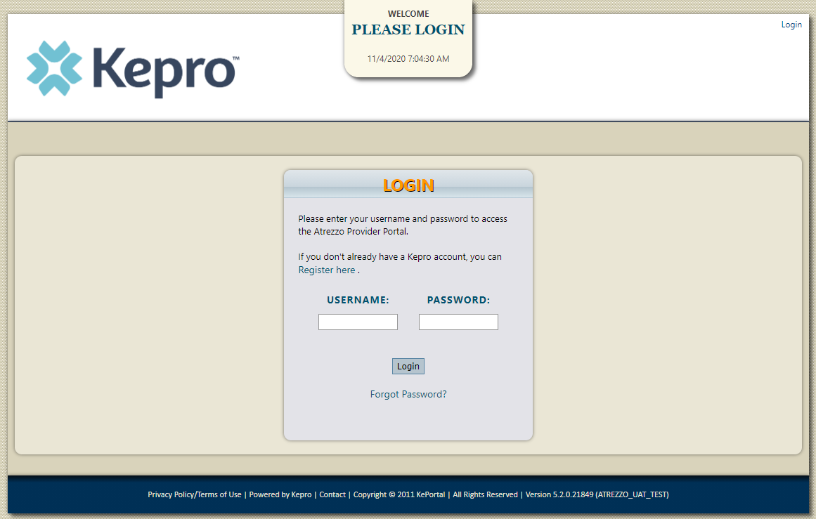
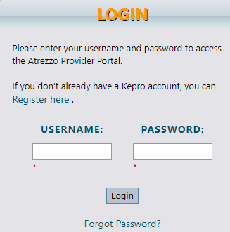
Atrezzo Login
Enter in your username and password
Notes:
Once you click on the Atrezzo login button, you will be brought to the actual login page. Here you will enter in your username and password. If you have forgotten your password, click on the I forgot password link. This will ask you to provide your username and the answer to your security question. Once you have answered your security question, you will be able to reset your own password.

Slide 6
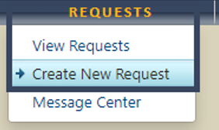
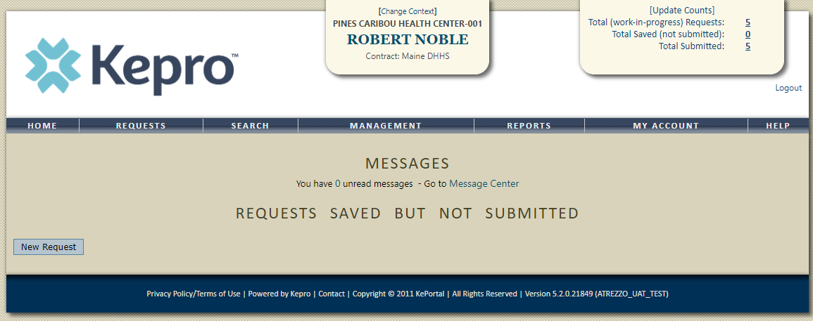

Creating the Request
Once you have successful logged in, you will be brought to the home screen of Atrezzo. There are two ways to create a new request. You can click on New Request at the bottom of the home screen, or by click on the requests tab and selecting create new request.
Notes:
Once you have successfully logged in to Atrezzo, you will be brought to the home screen of Atrezzo. There are two ways to create a new request. You can click on New Request at the bottom of the home screen, of by clicking on the requests tab and selecting create new request.

Slide 7
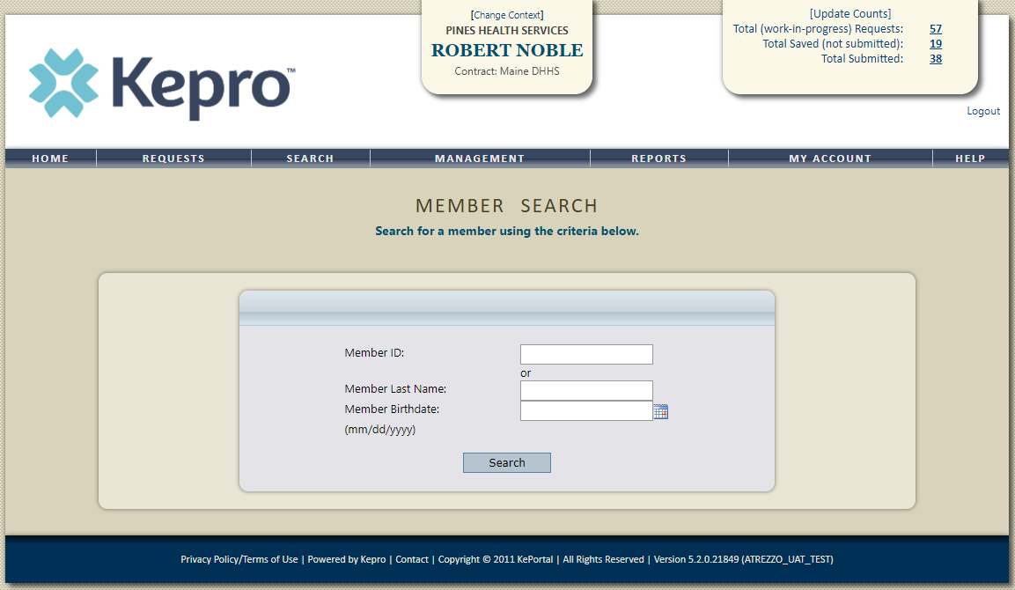
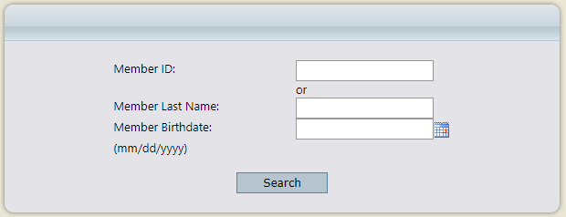
Creating the Request
Enter in the member’s MaineCare ID in the Member ID box. If you don’t have the member’s MaineCare ID, you can search for the member by entering in the member’s last name and date of birth
Notes:
Enter in the member’s MaineCare ID in the Member ID box. If you don’t have the member’s MaineCare ID, you can search for the member by entering in the member’s last name and date of birth and click search.

Slide 8
Creating the Request
Enter in the member’s MaineCare ID in the Member ID box. If you don’t have the member’s MaineCare ID, you can search for the member by entering in the member’s last name and date of birth
Notes:
If the consumer does not have MaineCare, you will be prompted to Create a Temporary member. This should be used for OBH Funded consumers who do not have a MaineCare ID. To create a temp member, enter in the last name and DOBH and click search.

Slide 9
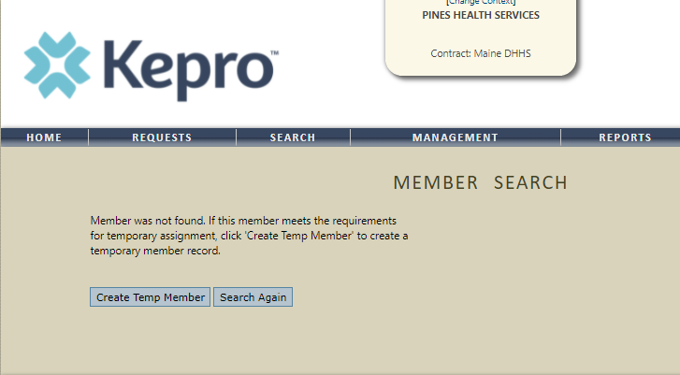

Creating the Request
Notes:
On the next screen, click Create Temp Member

Slide 10
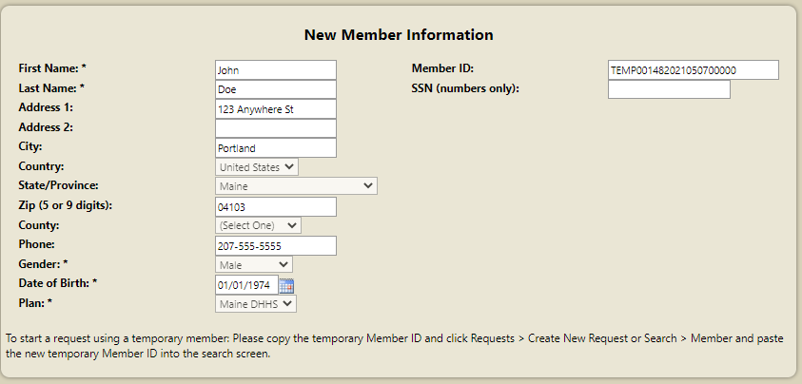
Creating the Request
Notes:
On the New Member Information screen, fill in the member’s demographic information and click Create Member Record. You will notice by clicking the create member record, that the member ID box displays a temporary ID. This temporary ID will act as the Member’s ID

Slide 11
Creating the Request
Notes:
Once you create the Temp ID, click the Requests Tab and select create new request, then enter in the member’s temp ID in the Member ID box and click search.

Slide 12
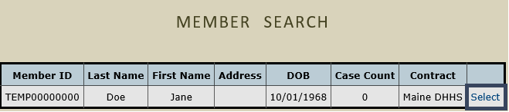
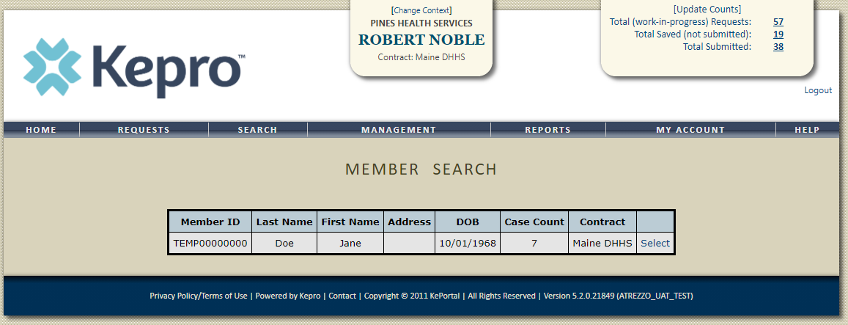
Creating the Request
Click on select once the member appears in the member search screen.
Notes:
Once the member appears in the member search screen, click on select to start the request

Slide 13
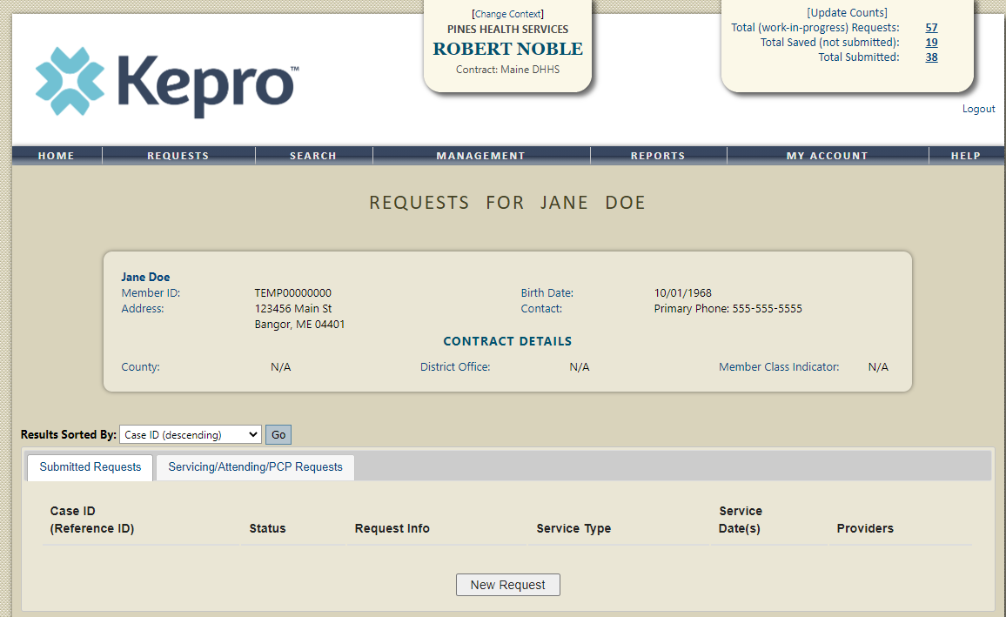
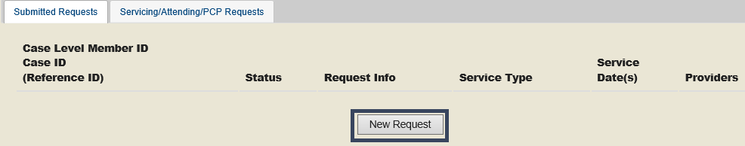
Creating the Request
Click on New Request at the bottom of the Request screen
Notes:
Click on New Request at the bottom of the Request screen

Slide 14
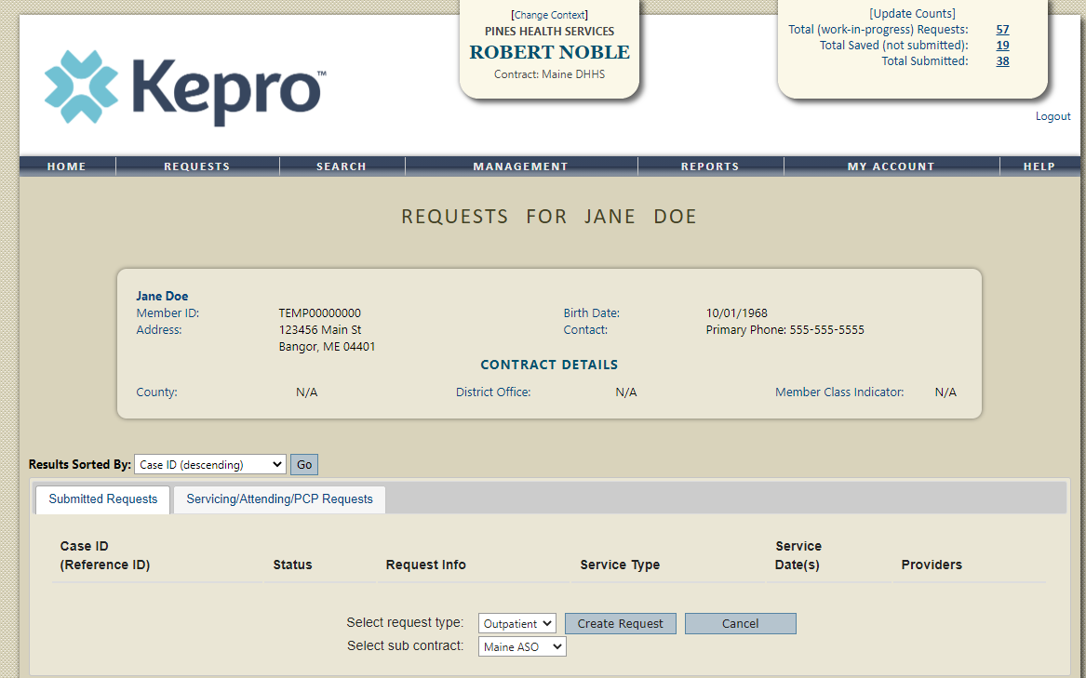

Creating the Request
Select Outpatient as the request type
Notes:
In the select request type box, choose outpatient. The select subcontract will default to Maine ASO. Click Create request to continue.

Slide 15
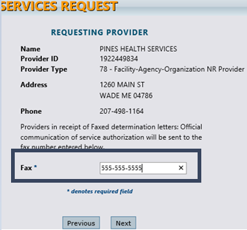
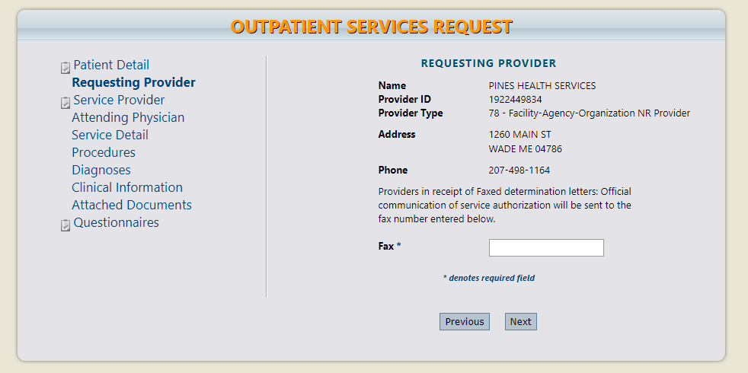
Requesting Provider Page
Enter in your agency’s fax number if not already indicated.
Notes:
Once you have clicked create request, you will be brought to the Requesting Provider page. If your agency’s fax number is not already indicated, please enter in the fax number and click next.

Slide 16
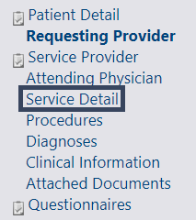
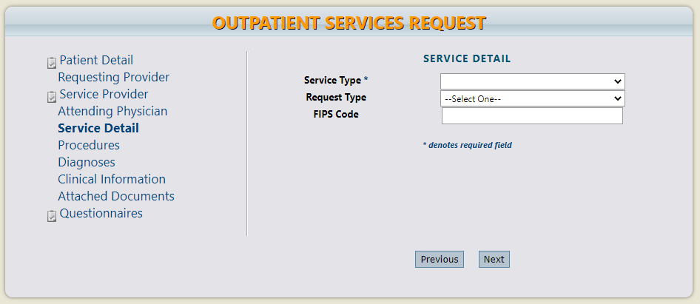
Service Detail Page
Click on the Service Detail page
Notes:
Using the tabs on the left-hand side of your screen, click on the Service Detail page. The Service Provider and Attending Physician pages are not required for Referral Refusal Requests.

Slide 17

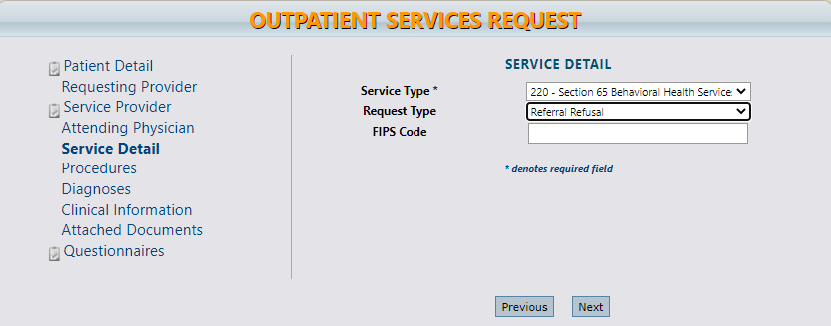
Service Detail Page
Complete the Service Type and Request Type
Notes:
In the service type box, enter in Section of MaineCare policy for which you are requesting to refuse the referral. In the Request Type box, select Referral Refusal. Click next to navigate to the next page.

Slide 18
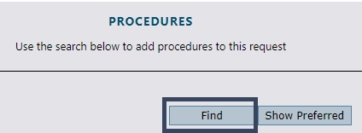
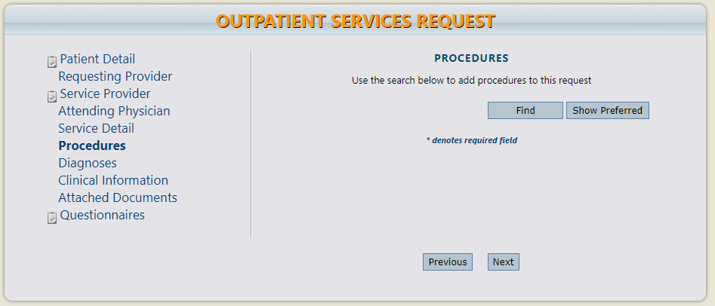
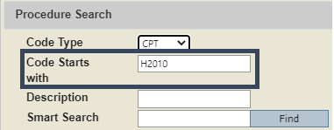
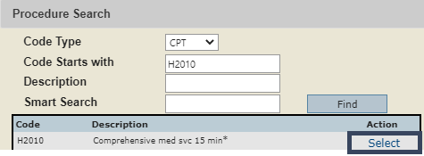
Procedures Page
Enter in the appropriate procedure code
Notes:
On the procedures page, enter procedure code for the service you are requesting the refusal for. In this example we used Adult Medication Management. Click on find, then enter in the procedure code or description of the code and click find. When the procedure appears, click on select under action. This will add the code to your request.

Slide 19
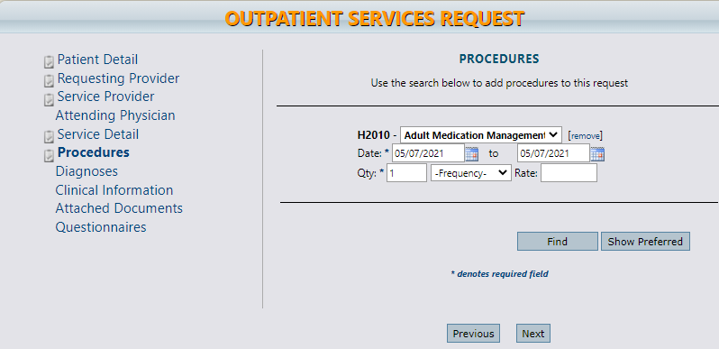

Procedures Page
Enter in the start date, end date, and one (1) unit.
Notes:
Once the code has been added, indicate the start as the date the request is being submitted. Enter in the start and end date for the date you are submitting the request. In the quantity box, enter in 1. Click next to continue.

Slide 20
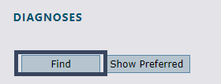
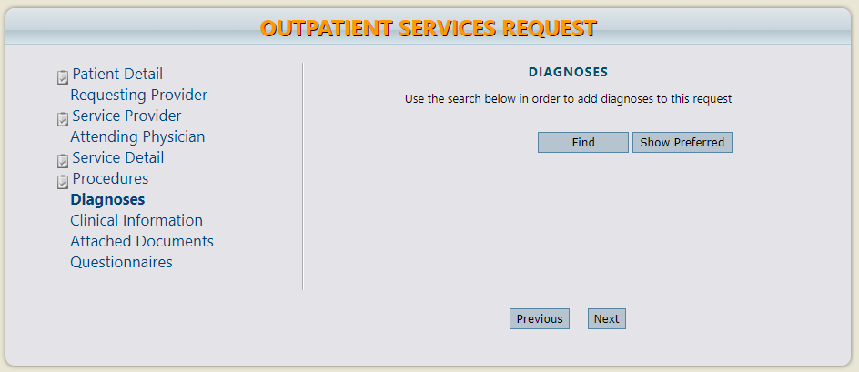
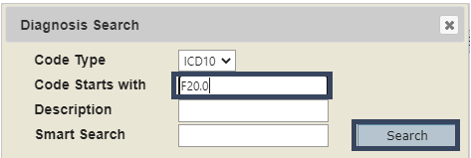
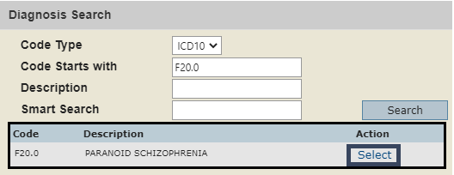
Diagnosis Page
Enter in the primary diagnosis code and any subsequent diagnoses.
Notes:
On the Diagnosis page, enter in the member’s primary diagnosis and any other subsequent diagnosis if known. If you do not know the diagnosis enter R69 for illness unspecified. Click on find, enter in the diagnosis code or description and click search. When the diagnosis code appears, click select under action to add the code to the request. Repeat the same steps to add each diagnosis code. Click next.

Slide 21
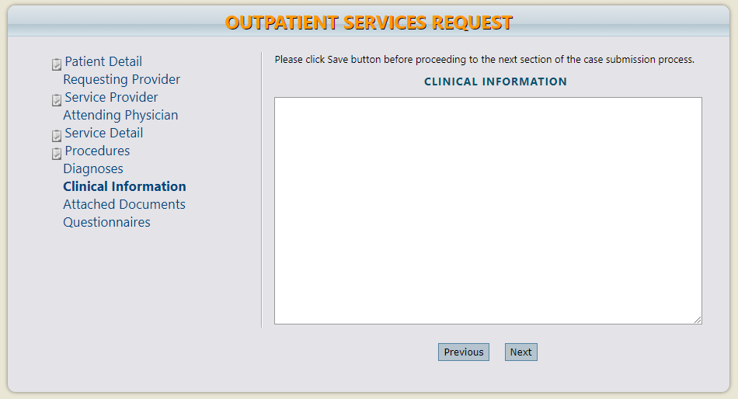

Clinical Information Page
Clinical information page is not required
NOT REQUIRED
Notes:
Using the tabs on the left-hand side of your screen, click on the Attached Documents page. The Clinical Information page is not required for Referral Refusals. All information pertaining to the referral refusal will be submitted via the questionnaire.

Slide 22
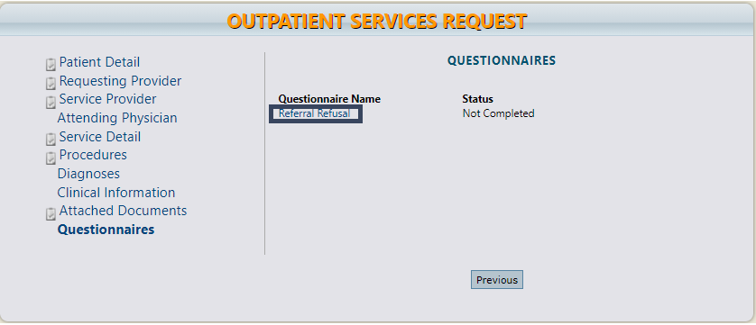
Questionnaire Page
Complete the Referral Refusal Questionnaire
Notes:
Click on the Referral Refusal Questionnaire and complete the questionnaire.

Slide 23
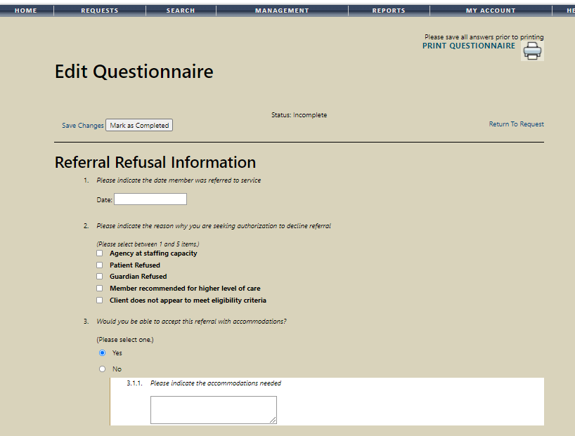
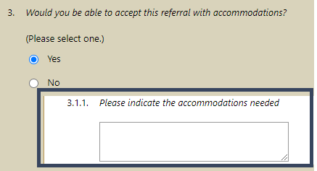
Questionnaire Page
Notes:
Please note, that as you answer the questionnaire, some questions will cascade to additional questions if more information is required.

Slide 24
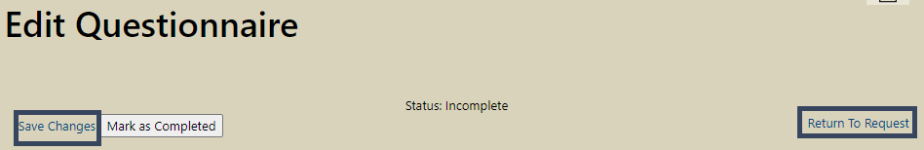
Questionnaire Page
Please Note: The questionnaire will be saved but not marked as completed
Notes:
When the questionnaire has been completed, click on the save changes button and then click on Return to Request. It is important that the questionnaire is filled out completely as this is where we will be capturing most of the information pertaining to the Referral Request..

Slide 25
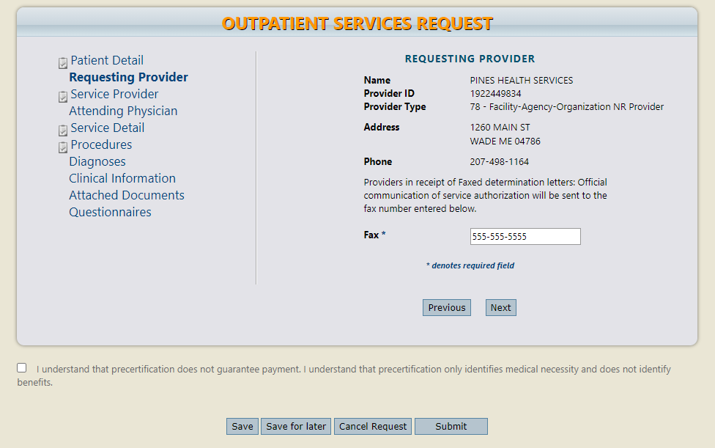
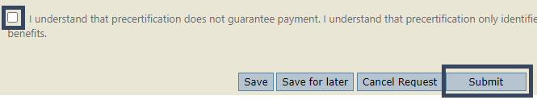
Submitting the Request
Select the pre-certification acknowledgement and click submit.
Notes:
Once you have returned to the request, scroll to the bottom of the page and check the pre-certification statement and then click submit.

Slide 26
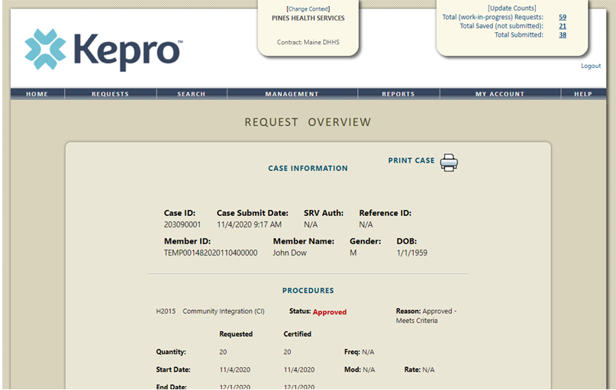

Submitting the Request
.
Once the case has been submitted it will bring you to the request overview page. This will be a receipt of all information provided in the request. It is important to document the Case ID to reference this request at a later time.
Please note: You will also be able to search and find the consumer by other identifying information like Name, DOB, etc.
Notes:
Once the case has been submitted it will bring you to the request overview page. This will be a receipt of all information provided in the request. It is important to document the Case ID to reference this request at a later time
Please note: You will also be able to search and find the consumer by other identifying information like Name, DOB, etc. If calling Kepro regarding the referral, two pieces of identifying information will be required to confirm the member’s identity. For example, a Case ID and member’s name.

Slide 27
Part Two
Post Submission
Notes:
Now that we have reviewed the process for submitting a Referral Refusal request, we will review what happens post submission

Slide 28
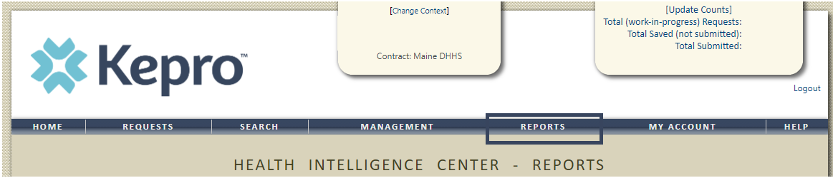
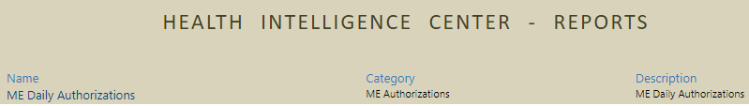
Daily Authorization Report
Notes:
Office of Behavioral Health will get a daily report of all Referral Refusal requests and will document their findings in your case. You can check on the status of your request at any time by accessing the Daily Authorization Report.
The Daily Authorization Report is the primary way Kepro communicates to providers regarding the status of a case. In the Atrezzo portal, users who have been setup as a Group Admin + Reports or Admin +Reports User will have a Reports tab. Within the reports tab, you will find the Daily Authorization Report

Slide 29

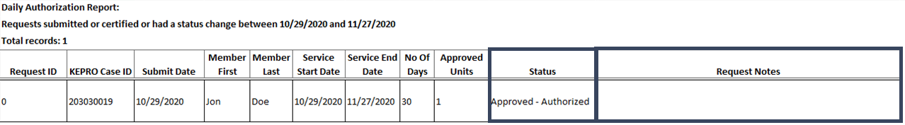
Checking for a Service Notification
Notes:
In your daily authorization report, select today’s date for the start and end date, select the request type as Referral Refusal, and click view report. Once the report runs, any cases that have been entered in Atrezzo under your agency’s NPI number will display. The report will provider you with a Kepro Case ID, start date, Status and notes section which will show any notes that have been added to the case.

Slide 30

Questions?
Toll-Free Phone: (866) 521-0027
Option 1 – Member Services
Option 2 – Katie Beckett
Option 3 – Provider Relations
Option 4 – Care Management
Option 5 – Appeals
Email: ProviderRelationsME@Kepro.com
www.qualitycareforme.com
Notes:
Thank you for joining the Kepro Referral Refusal Training. If you have further questions or need assistance, please call us at 866-521-0027. For technical assistance, please press Option 3 to reach a member of our Provider Relations Team. You can also reach a member of our Provider Relations Team via email at ProviderRelaitonsME@Kepro.com. To reach a member of our clinical team, press option 4, and to reach our appeals department, press option 5. Our hours of operation are Monday thru Friday 8am to 6pm.

